Slide 1
Digital Portfolio
STUDENT NAME : BAMILA K
REGISTER NO AND NMID : 24132120500122007 AND
7D15EAC8D146C8AB97D4F6653ACA0CE4
DEPARTMENT : BCA
COLLEGE: COLLEGE/ UNIVERSITY : SIDDHAR SIVAGNAANI ARTS AND SCIENCE
COLLEGE, BOMMAYAPALYAM AFFILIATED TO
ANNAMALAI UNIVERSITY.

Slide 2
STUDENT POTFOLIO :

Slide 3


AGENDA
Problem Statement
Project Overview
End Users
Tools and Technologies
Portfolio design and Layout
Features and Functionality
Results and Screenshots
Conclusion
Github Link
3/21/2024 Annual Review

Slide 4

PROBLEM STATEMENT
Many students and freshers do not have a proper platform to showcase their skills and projects.Traditional resumes are not interactive and cannot display live project work.There is a need for a personal portfolio website that highlights skills, achievements, and contact details in an attractive way.This project focuses on creating such a website to solve this problem.

Slide 5

PROJECT OVERVIEW
•Learned how to design and structure a portfolio website.
•Understood the use of HTML, CSS, and JavaScript.
•Explored responsive design and hosting.
•Faced some challenges but improved problem-solving skills.
•Overall, the project was useful and increased my knowledge.

Slide 6

WHO ARE THE END USERS?
•Recruiters / Employers – to see my skills, projects, and contact details.
•Teachers / Evaluators – to review my project work and learning.
•Friends / Classmates – to know about my projects and achievements.
•General Audience – anyone who wants to know more about me.

Slide 7

TOOLS AND TECHNIQUES
HTML was used to create the structure of the website, including pages and sections.
CSS was applied for styling, such as colors, layouts, and responsiveness, so the design looks good on different devices.
JavaScript was added to bring interactivity, like navigation menus, animations, and form validation.
I worked on the project using a code editor (VS Code/CodePen).
Finally, I hosted the website using GitHub Pages so it can be accessed online.

Slide 8
POTFOLIO DESIGN AND LAYOUT
My portfolio design includes sections like Home/About Me, Projects, Skills, and Contact. I kept the layout simple, user-friendly, and responsive so it works well on both mobile and desktop devices.
8

Slide 9
FEATURES AND FUNCTIONALITY
•A navigation menu for smooth movement between sections.
•Responsive design, so the website adjusts to mobile and desktop screens.
•Project showcase with descriptions and links.
•Contact form of or details to allow communication.
•Interactive elements like hover effects, animations, or buttons for a better user experience.

Slide 10
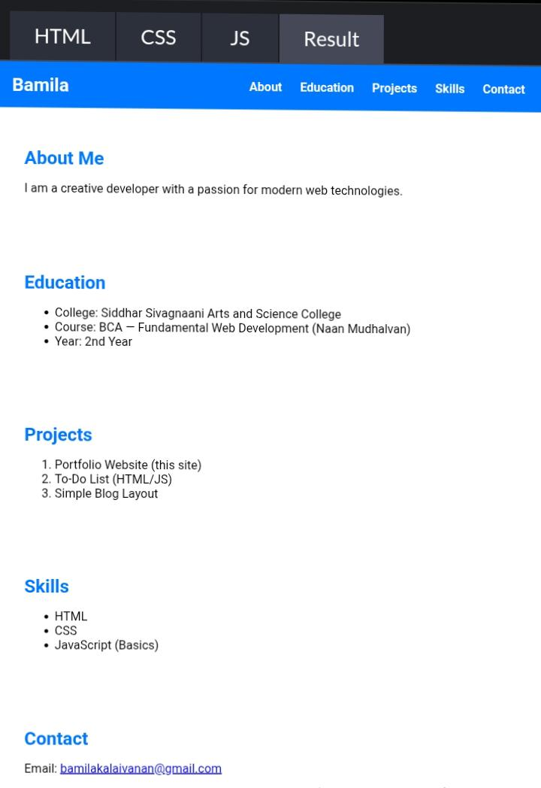

RESULTS AND SCREENSHOTS
3/21/2024 Annual Review
10

Slide 11
CONCLUSION
Through this project, I learned how a portfolio website is made using HTML, CSS, and JavaScript. It gave me basic knowledge of web design and hosting.
11

